Slide 1

Welcome to DCU Business School
September 2016

Slide 2

DCU – The University of Enterprise
Contents:
Linking Education and Human Capital to Enterprise
Dublin City University (DCU) Business School
  Faculties, Centres, Numbers
  Programs, Operating Model
Centre for Executive & International Education (CEIE)
  Programs, Accreditations
  Enterprise Links, Disruptive Technologies, Publications
  International Co-operations
The Abu Dhabi Landscape
DCU Business School & Abu Dhabi
  Integrating Operating Models
  Knowledge Transfer
  Direct & Indirect Socio-economic Impact

Slide 3

Human Capital & Higher Education
(a universal problem)
Graduate gaps between supply and labour market demand have remained constant
Employers and student dissatisfaction with work related skills gained from higher education institutions have remained constant
Relevance of the major to employment is consistently
difficult to forecast accurately
Fields of study shortages and surpluses aggregations have remained constant
Female unemployment in higher skilled area’s has
remained high

Slide 4




Human Capital Role
Critical to enabling Enterprises in Ireland
Regulatory (ownership, IP Protections, private enterprise legislation)
Goods and Labour Market efficiency
Laws and Regulations
Strong Enterprise Enabling Environment
Swift and coordinated internal government systems
Technology readiness
Financial markets development
Financial Resources
Implementation Excellence
Industrial financing, state owned enterprises, procurement leverage, raw materials, local content, corporate tax, customer exemptions, export credit
Infrastructure, Energy & Human Capital
Competitive energy, fully developed economic zones, ports, airports, rail, roads, industrial clusters, human resource availability, robust R&D environment, higher education and training.

Slide 5

DCU Faculties
Faculties:
DCU Business School | Academic Groups x 5
Economics, Finance & Entrepreneurship; Accounting; HR Management & Organisational Psychology; Management and Marketing
CENTRE FOR EXECUTIVE & INTERNATIONAL EDUCATION (CEIE)
DCU Institute of Education | Academic Groups x 6:
Arts Education and Movement; Human Development; Inclusive & Special Education; Language, Literacy and Early Childhood Education; Policy & Practice; STEM Education, Innovation and Global Studies
Faculty of Science & Health | Academic Schools x 6 :
Mathematical Sciences; Chemical Sciences; Physical Sciences; Biotechnology; Nursing & Human Sciences; Health & Human Performance
Faculty of Humanities & Social Sciences | Academic Schools x 8 :
Applied Languages & Intercultural Studies; Communications; English; History & Geography; Theology, Philosophy and Music; Fiontar & Schoil na Gaeilge (Irish studies); Education Studies
Faculty of Engineering & Computing | Academic Schools x 3:
Mechanical and Manufacturing Engineering; Electronic Engineering; Computing

Slide 6

DCU Business School in Numbers
3,072 students
2,458 Undergraduate Students
549 Taught postgraduate students
65 Doctoral Students
1165 International Students (563 PNU,SA);…31.4%
On campus 602 ;…19.1%.
229 in Princess Nourah University (PNU), Saudi Arabia
80% active researchers (publishing/doing PhD’s)
70% publishing in Top Quartile Journals
2,800 industry attendees at events/conferences
500 Students working with industry (INTRA/Practicum)
Notes:
563

Slide 7

DCU Business School Programmes
6 Undergraduate Programmes
3 Undergraduate Programmes (PNU, Riyadh))
15 Full time & Part Time Postgraduate Programmes
1 Full time Post Graduate Programme (PNU, Riyadh)
25 Centre for Executive & International Education (CEIE)

Slide 8

DCU Business School Operating Model
Teaching & Learning
Enterprise education spine confirms DCU Business School as an Innovator in Teaching & Learning
Research
Established research centres in trust, leadership and talent management, cloud computing, family business and
marketing technologies
International
Expanding the International footprint by becoming a leading Business School education provider in the Arab World
Industry Engagement
Embeds faculty and student entrepreneurs through shared working spaces and objectives in the Business School

Slide 9

Centre for Executive & International Education (CEIE) DCU Business School
Established by DCU Business School to provide accredited programmes, Leadership and Management Development programmes to organisational leaders across all economic sectors
CEIE operates as an integral part of the Business School and provides a dedicated service to its clients, both at organisation and individual participant level
CEIE is first point of contact for programmes delivered by DCU Business School both in Ireland and Internationally

Slide 10

DCU Business School
DCU Business School delivers international accredited programs in and for Universities, Corporations and Organisations
DCU Business School’s education is recognised for its distinctive and
high quality student experience
DCU Business School’s published research advances knowledge and professional practice in business disciplines
DCU Business School’s industry engagement is a hallmark of our activities
DCU Business School’s reputation as a provider of business knowledge and education is recognised nationally and internationally

Slide 11

DCU Business School’s place in the world of business schools
DCU Business School has confirmed its position as a world-leading business school with the award of AACSB Accreditation placing it in the Top 5% of the World’s Business Schools
*AACSB standards require excellence in areas including:
Strategic Management & Innovation
Student, Faculty and Staff Engagement
Teaching & Learning
Academic, Professional and Industry Engagement
Curricula responsiveness to the needs of business
* The Association to Advance Collegiate Schools of Business (AACSB), the world’s oldest and most prestigious global accrediting body for business schools

Slide 12
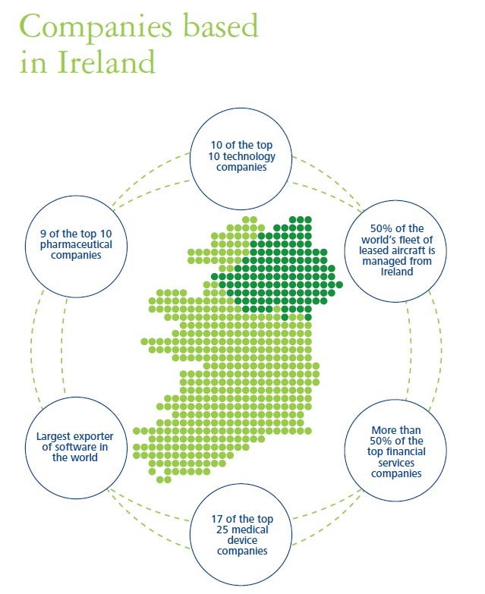
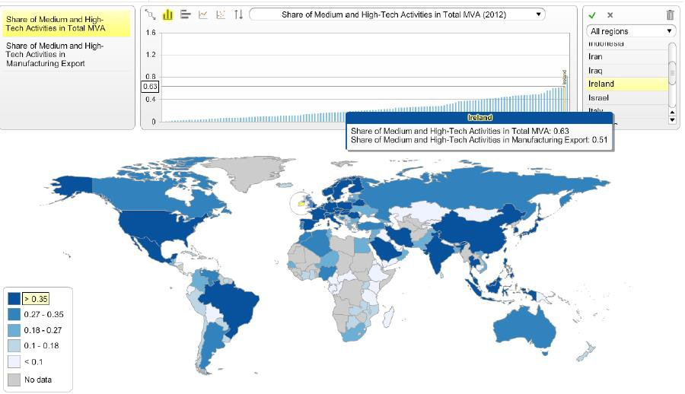
DCU Business School Operating Model Links
Education and Human Capital to Enterprises
st
for skilled labour that is readily available (source IMD Competitiveness Yearbook)
for Foreign Direct Investment and technology transfer (source: World Economic Forum Global Competitiveness)
in Europe for best country for business (source: Reuters)
for Inward Investment by quality and value (source: IBM Global Location Trends Report)
for real corporate taxes (Source: IMD World Competitiveness Yearbook)
For investor protection in Europe (Source: The World Bank IFC Doing Business Report)
‘Ireland’s education system ranks 7th in the word for meeting the needs of a competitive economy’
Source: IMD World Competitiveness Yearbook

Slide 13
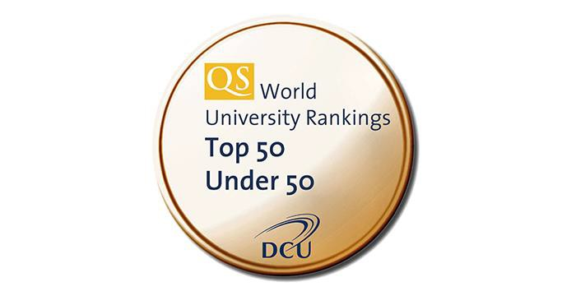

DCU Business School Operating Model Links
Education and Human Capital to Enterprises
DCU Business School Mission
To educate leaders and professionals for the global marketplace.
Through our teaching, our research and our engagement with industry, we proactively contribute to the development of individuals, industry and society.
Dublin City University
University of Enterprise
“…a research-intensive, globally-engaged University of Enterprise, distinguished by the quality and impact of its graduates and its focus on the translation of knowledge into societal and economic benefits.”
Ireland’s fastest growing university! 16,000 students
‘Transforming Lives & Societies’

Slide 14
DCU Business School Postgraduate Programmes Full & Part Time
MSc in Electronic Commerce
MSc in Accounting
MSc in Finance
MSc in Human Resource Strategies and Management
MSc in Management (Business Strategy)
MSc in Marketing
MSc in Digital Marketing
MSc in International Management
MSc in Safety & Health at Work
MSc in Human Resource Strategies
MSc in Emergency Management
MSc in Investment, Treasury and Banking (Capital Markets)
MSc in Organisational Change and Leadership Development
Executive MBA
Professional Doctorate (PhD) Programs
Customised Executive Education Programs

Slide 15

DCU Business School Postgraduate Programmes Full & Part Time
Pre-Masters International Foundation Programme M.Sc. in Electronic Commerce (Business)
M.Sc. in Electronic Commerce (Technical)
Executive MBA M.Sc. in Accounting M.Sc. in Finance
M.Sc. in Human Resource Management M.Sc. in Human Resource Strategies M.Sc. in Management (Business)
M.Sc. in Management (Strategy)
M.Sc. in Work and Organisational Psychology/Behaviour MSc in Emergency Management
MSc in International Management MSc in Investment, Treasury & Banking MSc in Digital Marketing
Professional Diploma in Accounting
MSc in Management (Aviation Leadership)

Slide 16

Centre for Executive & International Education Programmes
Executive Programmes
Enterprise Ireland (EI) Management 4 Growth (M4G)
Enterprise Ireland (EI) Platform4Growth (P4G)
Invest Northern Ireland (InvestNI) Leadership Team Programme (LTP)
Leadership in Local Government Programme (Delta State, Nigeria)
Educating Entrepreneurs (Malaysian Ministry of Higher Education)
IPO Programme (with Irish Stock Exchange)
SpringBoard Programmes (with DCU Ryan Academy)
Graduate Certificates in Management; Digital Marketing; Sustainable Energy & Finance
Open Programmes (with DCU Ryan Academy)
Graduate Certificates in Entrepreneurship, Innovation in Social Enterprise
DCU@PNU
(Princess Noruah bint Abdul Rahman University; Riyadh, KSA)

Slide 17
Accreditations & Professional Memberships
Accreditations | Professional Memberships
Association to Advancement of Collegiate Business Schools (AACSB) | Institute of Management Consultants & Advisors (IMCA)
Association of Chartered Certified Accountants (ACCA) | Global Association of Risk Professionals (GARP)
Association of MBA’s (AMBA) | Irish Association of Corporate Treasurers (IACT)
Chartered Institute of Management Accountants (CIMA) | Marketing Institute of Ireland (MII)
Chartered Institute of Personnel & Development (CIPD) | EMC Academic Alliance
Chartered Accountants Ireland (CAI) | Emergency Planning Society (EPS)
EPAS (operated by The Management Development Network - EFMD) | Institute of Chartered Accountants
FIBAA | Psychological Society Ireland (PSI)
Institute of Bankers (School of Professional Finance)

Slide 18

Industry Engagement
Representation
Sponsorship Research
Education & Training
Work-Integrated Learning Alumni
Events
15,000 industry interactions
175 industry funded research projects
10 DCU Business School Enterprise Start- Ups and Spin-Outs
Programme Credits (20%) for substantive
industry engagement

Slide 19


Industry Engagement at DCU Business School
DCU is Ireland’s University of Enterprise. We are in the Top 50 young universities in the world and have been ranked the most innovative in Ireland.

Slide 20


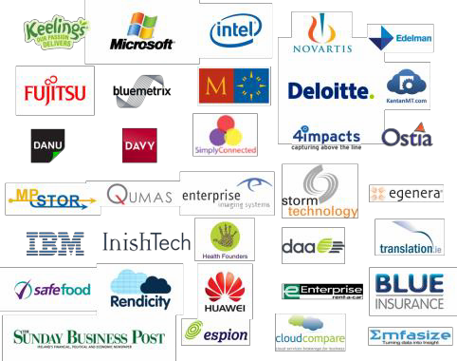



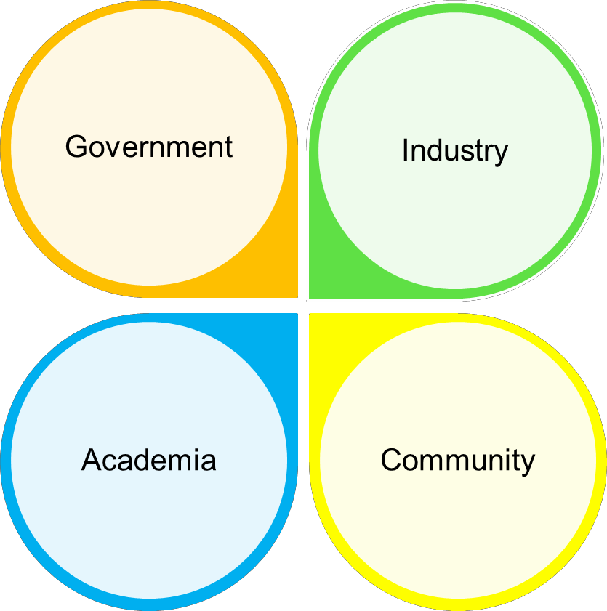



































Our quadruple helix approach to engagement brings government, industry, academia and users together.

Slide 21
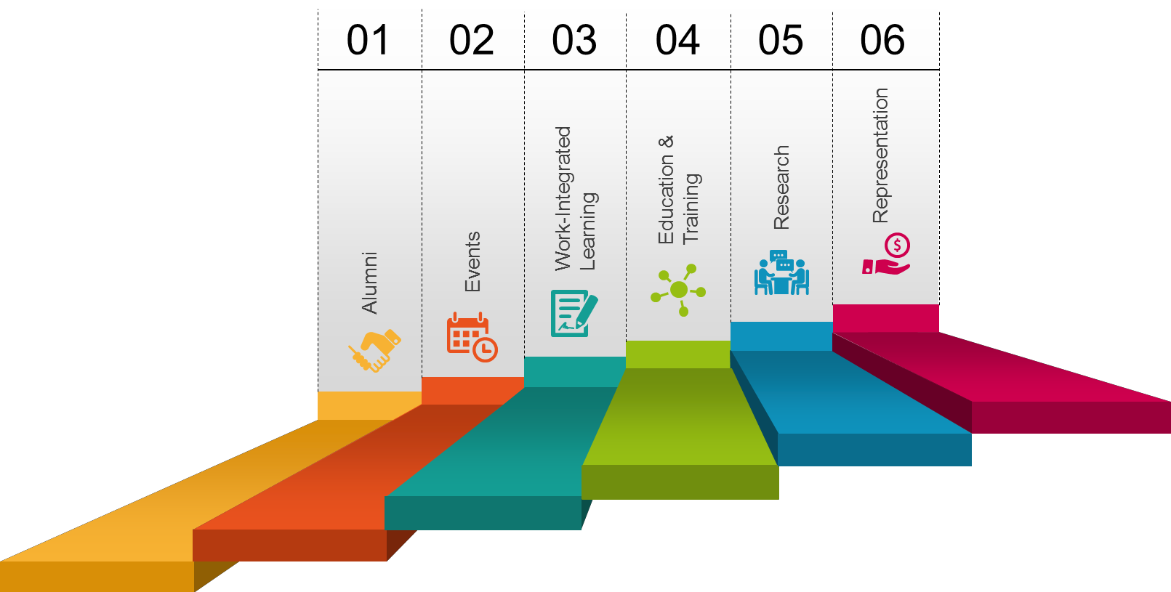
DCU Business School’s industry engagement strategy (Project 2020) is based on six pillars driven by a target of 20% industry engagement in all our activities.

Slide 22
DCU Business School programmes are built on an enterprise spine that is central to the DCU education ethos emphasising industry engagement and employability.
DICE
Practicum/ Placement
INTRA
NED
First Year
Second Year
Third Year
Final Year
Postgraduate
TWICE
NGM
BEST
LEAD
Full titles

Slide 23
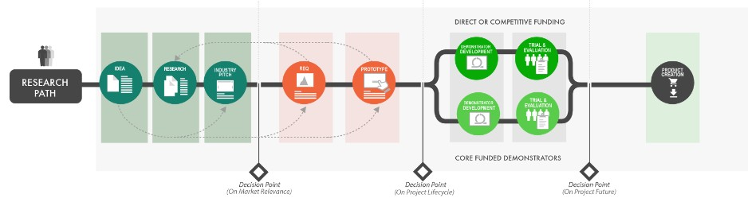
DCU Business School industry-engaged approach to research results in greater impacts for policy makers, industry and academia.

Slide 24




DCU is host to four research centres focussing on cloud computing and commerce (IC4), family business (CFB) and leadership and talent management (LTI), and aviation (DAI).

Slide 25
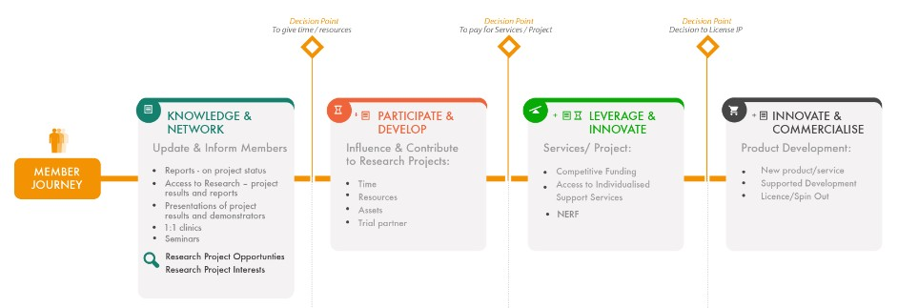
The Irish Centre for Cloud Computing and Commerce is the leading multi- disciplinary industry-led research centres in Ireland.

Slide 26






DCU Business School has a successful track record in winning competitive international funding with industry including FP7, Horizon 2020 and INTERREG.

Slide 27

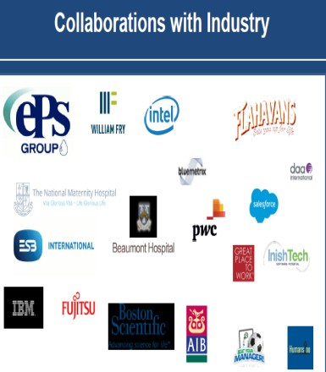


DCU Business School Enterprise Links
....DCU Business School Enterprise Cooperation matrix
-government and semi government
-healthcare & education
-materials & life sciences
-ict & cyber security
-advanced manufacturing
-future energy
-aviation, aerospace & defence
-agriculture, fisheries, food processing
-investment development & financial
services
-tourism
-entrepreneurship
-future energy
-ports, airports, railways
-infrastructure & real estate
-economic zones

Slide 28
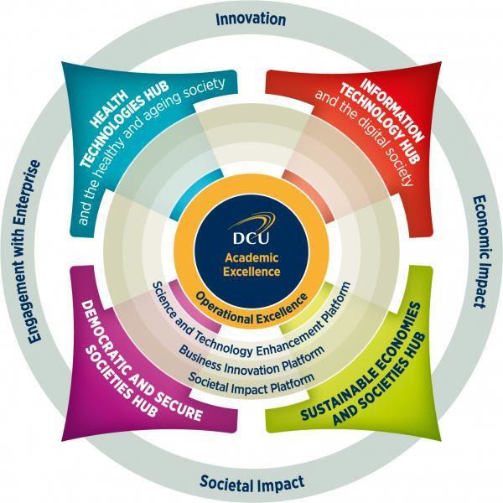
DCU Business School Enterprise Links
DCU research creates new knowledge and technologies to enhance capabilities in four key areas: health technologies, information technology, sustainability
and social resilience.
Research activity is championed by a Research and Enterprise Hub, which is a vehicle to facilitate interactions with external stakeholders. The Hubs help to establish links with industry and other enterprises, as well as with academic collaborators.
Each Hub has its own business development team which can introduce relevant DCU technologies and expertise to enterprises, and help enterprises connect with appropriate experts within DCU.
Please click here and use the buttons to explore the RESEARCH EXPERTISE within each Hub, as well as ASSOCIATED
TECHNOLOGY, INFRASTRUCTURE and relevant RESEARCH CENTRES.

Slide 29





DCU Business School Disruptive Technologies Links
…… DCUBS examples
significantly impacting all enterprise sectors
Digitization & Big Data
Consumerizationof Manufacturing
Social media is making consumers more aware of product options and companies’ track records of quality and delivery; consumers are also more impatient and more demanding of personalized / specialized products
This is pushing manufacturers to be more aware of consumers and develop B2B2C relationships
The adoption of digital technologies and big data in traditional industrial processes is improving areas such as supply chain management, performance monitoring and quality management through early problem detection and response, and understanding of market trends and demand, among many others
“Re-shoring”
Additive Manufacturing (3D Printing)
Increases in the technical sophistication of manufacturing and industry mean that more highly skilled workers are needed
This, combined with rising wages in Asia and the need to quicken time to market, is pushing companies to shift their production back to their home countries
Increasingly diverse and sophisticated 3D printing is having a major impact, creating more efficient manufacturing processes, more customized products, and shorter supply chains (as manufacturers make their own inputs)

Slide 30

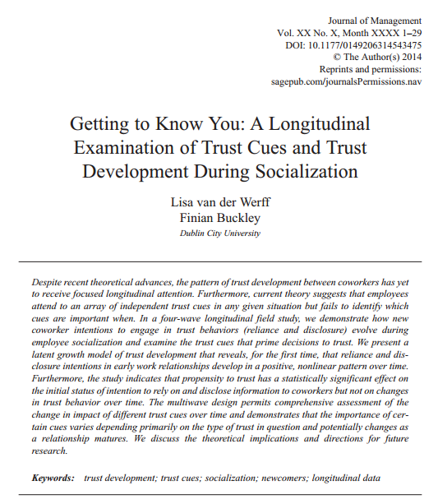

Publications
Our published research advances knowledge and professional practice in business
disciplines
1,649 ‘intellectual contributions’ from 63 staff
  310 peer reviewed journal articles
  126 book chapters
  27 books/monographs
  600 conference presentations
310 Peer Reviewed Journal (PRJ) articles from 48 staff
  255 (83%) in ‘priority’ ranked journals
  Of which:
• 83 in 3
• 17 in 4
PRJs PRJs

Slide 31
Areas of Expertise / Research Centres
Industry Funding |
Health
DCU Business School has won $175 m in industry funding
Leadership & Talent Management
Experts in both Management and HRM Groups Horizon 2020 Funding
Modelling and Simulation Research Group
DCU Leadership & Talent Management Institute The HR Roundtable
Cloud Computing
Family Business
Centre for Family Business Launched by An Taoiseach in 2014
Funded by PWC, William Fry and AIB
Irish Centre for Cloud Computing and Commerce (IC4)
Founding industry members include IBM, Intel, Fujitsu, Microsoft, Salesforce and Zartis

Slide 32










DCU Business School International Co-operations
Joint Programmes :–
BA Global Business
Business Studies International
MSc in International Management
International Study Visits:
China
India
Mexico
United Arab Emirates
USA

Slide 33




Operating Model Integration
Governance and Quality Assurance
DCU Quality Assurance
Standards Authorities
Professional Accreditation
Industry Accreditation
1
Programme Design, Management and
Delivery
2
Dedicated DCU Faculty and Support Staff on-site
Multi-level Institutional & Stakeholder Engagement
4
Knowledge Transfer
Inter-Institutional Student Engagement
Inter-institutional Staff Engagement
Cross-campus DCU staff Engagement
New industry relationships
Teaching practices
Evaluation methods
Learning technologies
Research dissemination
3

