Slide 1
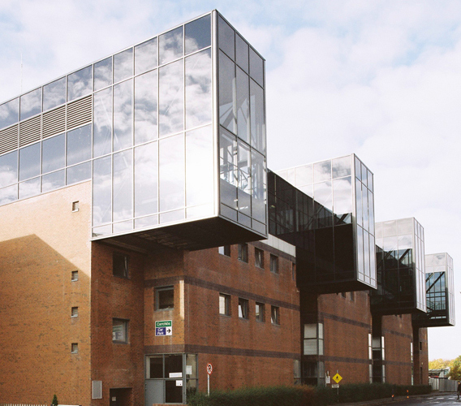
Methodolatry (from Scientism to Phenotypes) and PolyMeasures (from Adductive Reasoning and Propositional Logic to Psychophysics and Neurology) to Futures Research
Professor Luiz Moutinho
Professor of BioMarketing and Futures Research
DCU Business School, Dublin City University
Ireland
2016

Slide 2
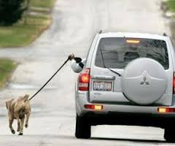
SCIENCE and Methodologies: Beliefs and Reality
The purpose of Science should take precedence over established methodologies...
Similarly, belief in a universal, inflexible scientific method that can guarantee truth belongs to scientism…
Some researchers are prone to the intellectual laziness which attempts to learn a given theory and then go on to treat such a theory /or methodology as though it were capable of explaining everything.

Slide 3
Methodology or Methodolatry?
Methodolatry describes the obsession with a particular method of investigation and the willingness to disfigure a therapy to preserve the sanctity of the method of inquiry.
If we are serious about coming to know something, then our research methods will have to be adapted to the nature of the phenomenon that we are trying to understand.

Slide 4
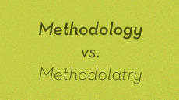
Methodolatry...
... consists in the need to reduce the object of research - defining it according to a criterion which says more about the methodology that has been applied than it does the actual object.

Slide 5
Methodology
Etymology (from Greek): meta + odos + logos A strong sense of being knowledge of a journey... A knowing of the way to go. How we know symbiotically determines our relationship with
what we know,
what we can know, and
how that object is subsequently able to appear before us.
But the very success of research methodology in achieving its aims can also become its Achilles Heel in which it fails most miserably to grasp its object….

Slide 6
Methodology (Cont.)
What is looked for in the research thought is the open space, the clearing, in which entities can reveal themselves.
Think about the differences and similarities between the Greek “methodos” as an adventurous or a questioning form of knowing, and the contemporary methodology as a knowledge of systems of analysis….
A problem occurs when the perimeters set by a methodology are confusedly identified with an exhaustive knowledge of the object – rather than a knowledge which is exclusively defined by an adherence to relevance, efficiency and rigour.

Slide 7
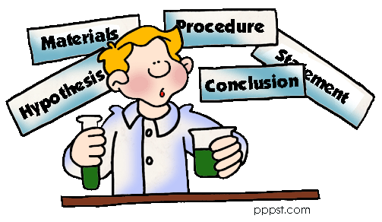
MethodS... State-of-the-Art
Techniques which bear
the imprints of logical positivism,
statistical investigation, and
the scientific method
continue to dominate.
* * *
Some critics say that high on the list of priorities of such methods is the dehumanization of research in order to reduce bias and increase “rigour”.

Slide 8
MethodS... State-of-the-Art (Cont.)
One of the drawbacks of employing rigorous, scientifically acceptable definitions lies in the nature of society and humankind → → strict guidelines for research often require the scholar to refrain from using insight, intuition, and other non-rigorous knowledge.

Slide 9
“Irritations and Fictions: The Boundaries Between Management Practice And Academic Research”
Interventions between the worlds of science and practice will initially be seen by the “recipients” more as “irritations” based on “fictions” rather than constructive contributions (Rasche and Behnam, 2009).
Some have responded to this problem by adopting a perhaps convenient but also rather facile way to resolve the contradiction by asserting that these two world views, those of research and of practice, are inevitably contradictory and therefore attempts to work between them are doomed to failure.

Slide 10
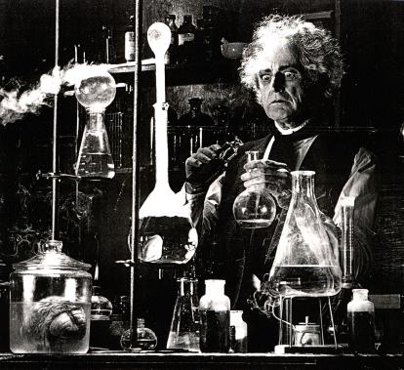
Knowledge for Theory and Practice
Scholars need to achieve the dual objectives:
of applied use and
advancing fundamental understanding of the field.
Testing and validation might be problematic because the external world does exist beyond research “real mirrors” and is changing at an incredible pace and flux.
Plausible models of reality are, therefore, essential for developing objective scientific knowledge.

Slide 11
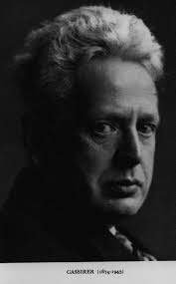
Knowledge for Theory and Practice (Cont.)
Ernst Cassirer, a neo-Kantian scholar, in extending Kant’s original insight, explored issues of progress in science by contrasting forms of scientific thought that focus on identifying the essential qualities of objects associated with observed regularities, with other forms of scientific thought that focus on constructing hypothetical models of underlying realities (Cassirer, 1923).
In the Aristotelian mode of investigation, the task of the scientist is to identify essential properties of the elements of nature that cause regularities in observed phenomena. In pursuing this fundamental task, scientists observe frequently occurring events, paying particular attention to elements in events that are associated with each other, and events that share phenotypical similarities.

Slide 12
Knowledge for Theory and Practice (Cont.)
The purpose of research in Aristotelian science is to identify frequently occurring events: only events that occur with a statistical frequency greater than chance reflect lawfulness.

Slide 13
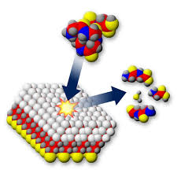
ADDUCTIVE REASONING IN RESEARCH
≡ putting together a theory by looking at different aspects of the event from different sources, utilising disputed information.
… avoiding...
Research Control – a means in research to exclude one or more explanations of the data.

Slide 14
ADDUCTIVE REASONING IN RESEARCH (Cont.)
A. Explananum
B. Explanation of Phenomenon, Explanation of Data, Explanans
The Compatibility of Ideographic Uniqueness and Nomothetic Constructs
C. Response Bias, Control/Exclusion, Partial – Report Superiority, Modus Tollens – Propositional Logic
TRUTH - VALUE
D. The Possibility of Objectivity
Sensory Information, Polymeasures
REDUCTIVISM REVISTED

Slide 15
Measurement in management sciences
Despite its importance, measurement has received less attention in the management sciences than it deserves.
Currently, there is an over-reliance on a narrow set of methods of measuring cognitive, affective, motivational, attitudinal and individual difference constructs that are often of interest in behavioural management research.
There is a need to expand the scope of the measurement methods commonly employed by management researchers and that a greater diversity of measurement methods would benefit the field by contributing to theory development and the pursuit of new areas of research.

Slide 16
POLYMEASURES
Bio-Physio – – Biological Measures + Physiological Measures | Lab-Mechanical Observation Neuroscience
Experience - Sampling Measures (ESM) | Self reporting of mental processes Validity-Correlation ESM. Measures with physio-measures, psychological tests and Behavioural indices.
Implicit / Indirect Measures | Functional Properties? Objective Property of the Measurement? Not self assessment, but another behaviour. They do not allow to register Stable Structures in, but, they can provide unique insight into effects of automatic processing on real-life behaviour. Mood, Emotion, Voice Prints, … , Facial Electromyography.
Self - Reporting Measures | Concerns about validity of causal conclusions - systematic response distortions. Method variance, mono-method bias, and the psychometric properties (reliability + validity) of questionnaire scales. Context-design of studies, statistical analyses.

Slide 17
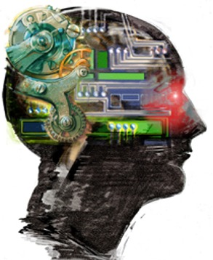
POLYMEASURES Biological Measures (Biometrics) – Mechanical Observation
Facial ElectroMyography (fEMG)
Facial Coding
Iris Recognition
Retinal Scan
Fingerprint Recognition
Handwritten Biometrics
Voice Prints
Voice Pitch Analysis
Utterance Analysis
Human-Computer Interaction
Vein Matching
Palm Vein Prints
Palm Dorsa
Scan Brain Waves
Pupillometrics
Heart Beat
Degree of Sweating
Glasses Mounted Cameras
Telemetric Measures for Electrodermal Activity, …

Slide 18
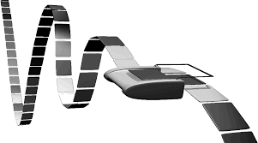
POLYMEASURES Physiological Measures – Neuroscience (1)
Brain Physiology ⇒ participant cannot change Δf/ΔL about response!
EEG – Electroencephalography – records electrical activity along the scalp. Voltage fluctuations from ionic current flows within neurons of the brain. Neural oscillations.
PET – Positron emission tomography – 3D image/picture of functional processes in the body. Pairs of gamma-rays. Tracer concentration.
MRI – or nuclear (NMRI) or MRT (tomography) – to visualise internal structures of the body. Uses magnetic field gradients that allow spatial information.
fMRI – measures brain activity by detecting associated changes in blood flow. BOLD/contrasts (hemodynamic response).
TMS – depolarisation or hyperpolarisation in the neurons of the brain. Uses electromagnetic induction with weak electric currents. Using a rapidly changing magnetic field.
Brain
Physiology

Slide 19
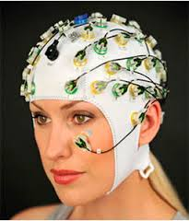
POLYMEASURES Physiological Measures – Neuroscience (2)
tDCS form of neurostimulation ... ... which uses constant, low current directly to areas of the brain via small electrodes. Can increase cognitive performance.
fNIRS – DOT (Functional Near–Infrared Spectroscopy) – – (Diffuse Optimal Tomography)
Advantages
used outside hospital environments
allows interaction with participants
less stringent in selection of participants.
Disadvantages
only reaches surface cortex
not possible to quest all the brain simultaneously.
Brain
Physiology

Slide 20
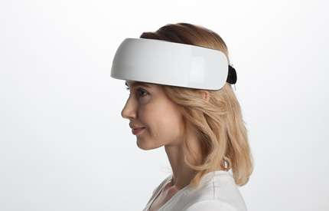
POLYMEASURES Physiological Measures – NEUROSCIENCE... NISRIT
NIRSIT:
a functional near-infrared spectroscopy neuroimaging device set to change the landscape of neuroscience research.

Slide 21
POLYMEASURES Physiological Measures – NEUROSCIENCE... NISRIT (Cont.)
NIRSIT... is a device based on the near-infrared spectroscopy principle, which
utilizes light to detect hemodynamic changes in the cerebral blood flow and
visualizes brain activation regions in the prefrontal area of the brain in real time.
Unlike other existing NIRS devices developed by other institutions (a spatial resolution of 3cm x 3cm), NIRSIT has improved its spatial resolution to a maximum of 0.4cm x 0.4cm, which is comparable to that of functional MRI (which is 0.3cm x 0.3cm).
Furthermore, NIRSIT is probably the one and only portable and wireless NIRS device designed to be used for brain research and clinical research purposes. A software application developed by the KAIST team allows the raw data extracted from the hemodynamic changes in the brain to be shown in real time on a tablet wirelessly connected to NIRSIT.

Slide 22
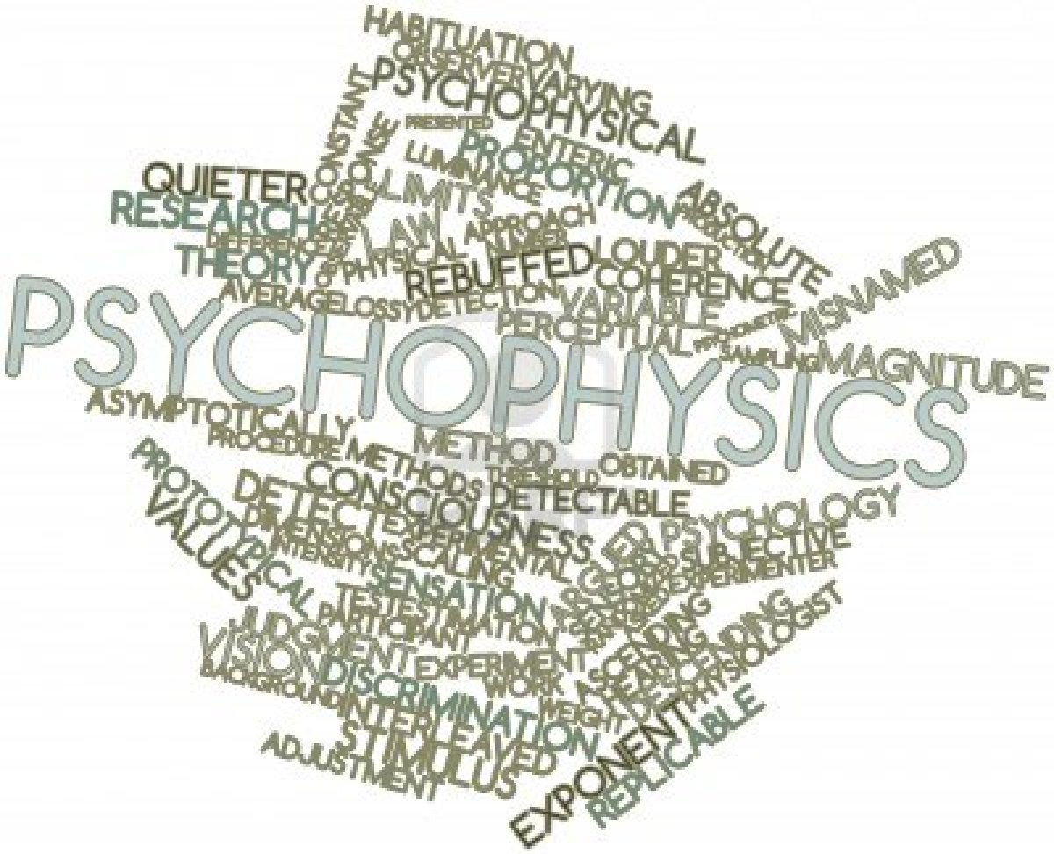
POLYMEASURES NEW MEASUREMENTS
Psychophysics: the branch of psychology that deals with the relationships between physical stimuli and resulting sensations and mental states.
New measurements:
The analysis of perceptual processes by studying the effect, on a subject’s experience or behaviour, of systematically varying the properties of the stimulus.
Reaction time to reveal attention, implicit preferences and decision factors.

Slide 23
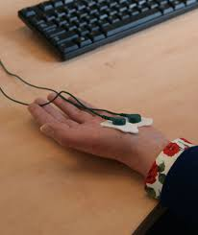
POLYMEASURES NEW MEASUREMENTS – COMPLEMENTARITY (Psysio-data)
Physio-data is unlikely to capture the full experience of emotion.
Physio-data is continuous and can be measured without the conscious introspection required for self-reporting. The big problem with conscious introspection about emotion is that is divorced from the way in which we tend to experience emotion in real life.
Physio-data is objective, can be reliably measured.
Physio markers: oxytocin, tuf-alpha, heart rate variability, galvanic skin response, dopamine,….

Slide 24
… but wait… there is more…!

Slide 25
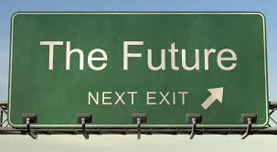
FUTURES RESEARCH METHODOLOGIES + METHODS

Slide 26
Experts-Based
Futures Research - methodologies + methods
EXPERTS-BASED
Consensus Analysis
Delphi
Causal Layered Analysis (CLA)
Real-Time Delphi
Cross Impact Analysis
Think Tanks
Scenario Planning/ Expert Systems / Artificial Intelligence
Online Mind Mapping
Back-casting
Online Group Discussions
Jury of Opinion
Morphological Analysis
Industry/Company X-Ray
Brain Monitoring
Analytic Hierarchy Process (AHP)

Slide 27
CONSUMERS/PSYCHOLOGICAL/CONTEXTUAL Mobile Ethnography
Futures Research - methodologies + methods
CONSUMERS/PSYCHOLOGICAL/CONTEXTUAL Mobile Ethnography
Consumer Shadowing
Consumers’ Imprinted Research
Swarms or Collectives Research (Physics and Biology)
In-situ Research
Futures Wheel: Participatory Method - Charrette
Digital Anthropology
Ethnographic Episodes
Mobile Ethnography
Ethnographic Mimicry
Mobile Information Technology (MIT)
Visioning/Preferred Futures
Means-End-Chain (MEC)
Living In Arrangements (LIA)
Digital Ethnography
Networked Narratives
Interpretive Simulations Sensory Ethnography

Slide 28
FORECASTING
Futures Research - methodologies + methods
FORECASTING
Judgemental Forecasting
Reference Class Forecasting
Missing Link Levels
Simulation Research
Prospective Surveys
Futurecast Measurement Indices

Slide 29
EXPERIMENTAL
Futures Research - methodologies + methods
EXPERIMENTAL
Consumer / Media Labs
Mock Environment
Eye -Tracking Research

Slide 30
and... thoughts for reflection

Slide 31
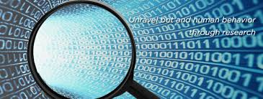
Thoughts for Reflection
Humans have always been a curious and limit-seeking species. It is very human to test for borders or improve processes, and ask questions.
Research is just the modern framework in which some of these processes are becoming canalized.
Research is always also an investment. As with every investment, two desires are connected to it: →

Slide 32
Thoughts for Reflection (Cont.)
First of all,  to maximize high quality results and secondly,  to decrease the associated risks of performing “unsuccessful” or less relevant research to a minimum.
The identification of the societal relevance of research projects is one way to achieve both “investment aims” and therefore to push research into a more fruitful direction by actually creating a measureable benefit for society as a whole or to solve a specific problem with implications for a subgroup of society.

Slide 33
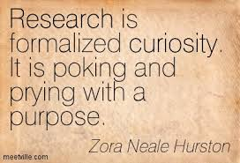
Final Intellection
The working hypothesis is that the status of knowledge is altered as societies and cultures enter what is known as the postmodern age.
Research is creating new knowledge.
Research is formalized curiosity. It is poking and prying with a purpose!

